Slide 1
— Students: F. Minutella | A Schiavo | M. Daole | M. Gómez ||
Sketches Recognition
Professors: C. Gennaro | F. Falchi | G. Amato | P. Bolettieri —

Slide 2
Project Description
Implement index LSH to allow fast similarity search on deep features and create an image search engine on top of it
Use the pre trained Deep Neural Network Inception to extract features from the dataset Sketches and the distractor MirFlickr
Index the extracted features using your search engine
Measure the retrieval performance of the image search engine
Fine tune the Inception for Sketches
Use the fine tuned Inception to extract features from Sketches and MirFlickr
Index the new extracted features using your search engine
Measure the retrieval performance of the image search engine using the new features
Compare the performance of the two features
Optional:
Build a web based user interface for your web search engine

Slide 3
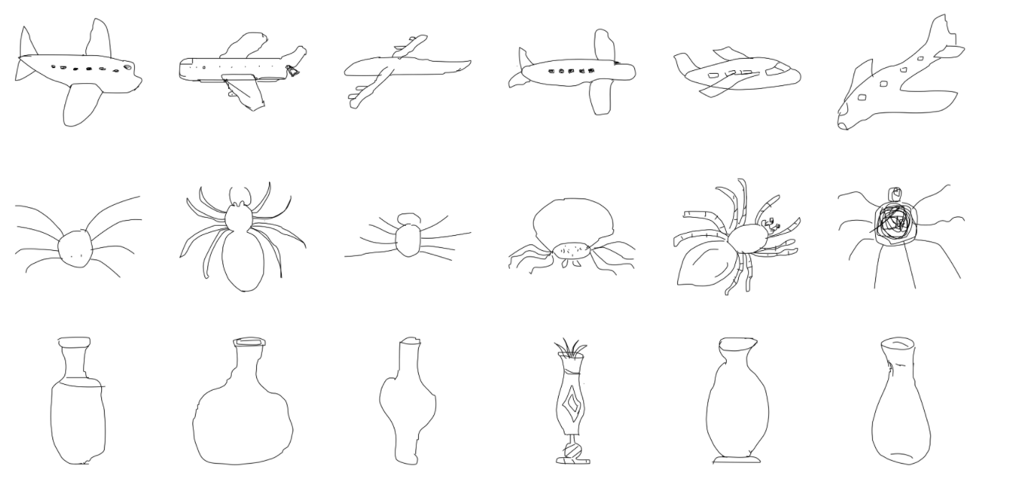
Our goal is to train machines to recognize and generalize abstract concepts in a manner similar to humans. As a first step towards this goal, we train our model on a dataset of hand-drawn sketches.

Slide 4
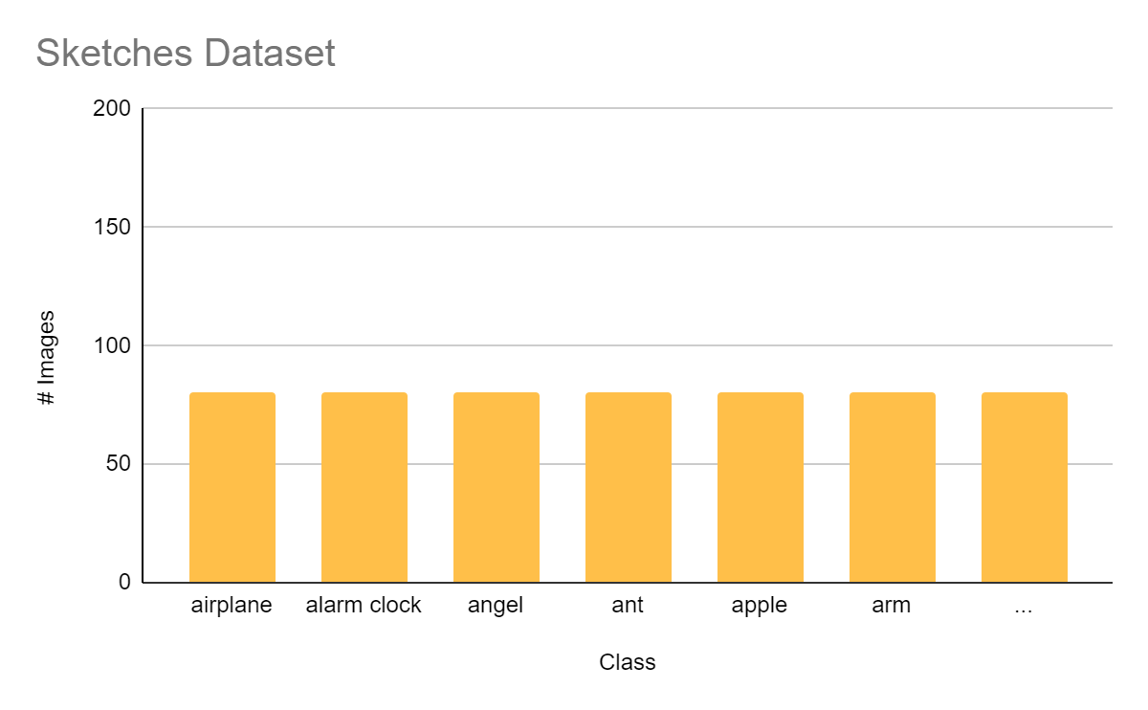
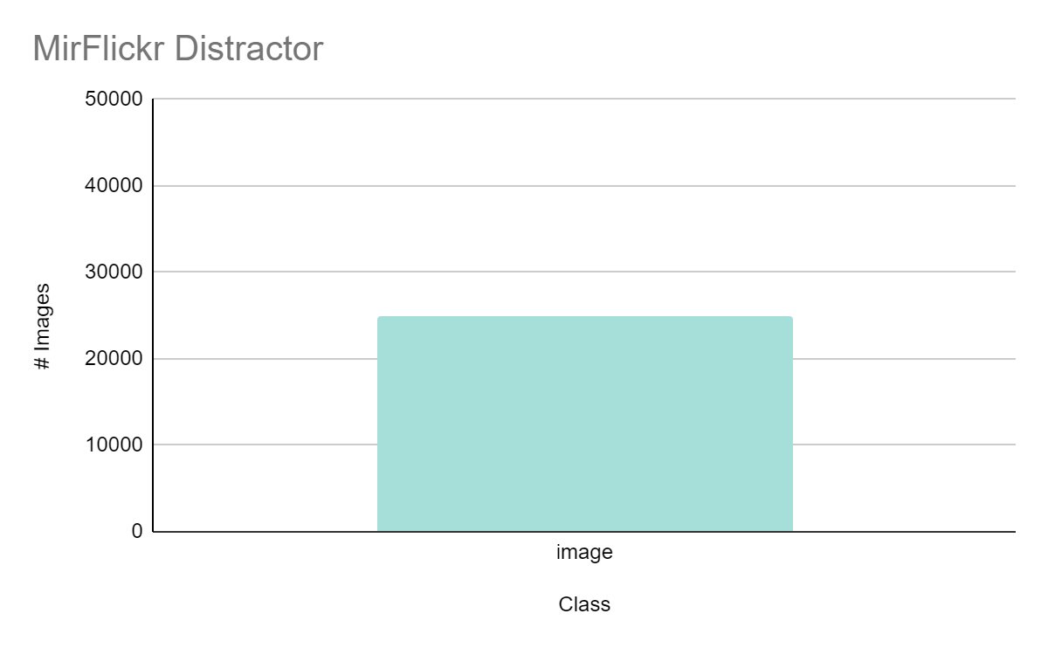
Distribution of our Datasets
250 Class and 20K Images
1 Class and 25K Images

Slide 5
LSH - Locality Sensitive Hashing
d2
d4
d1,d3
We don’t necessarily insist on the exact answer; instead, determining an approximate answer should suffice.
Similar Documents => Similar Hash-Code
For each document d:
Generate K hash-code
Insert Document into hash-table
1
2
3
4
5
6
7
8

Slide 6
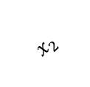
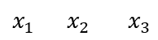
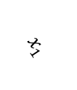
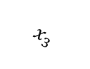
LSH - Locality Sensitive Hashing
Hash functions g() such that given any two objects p,q
If d(p,q) > c*r then Pr[g(p)= g(q)] is small
If d(p,q) ≤ r then Pr[g(p) = g(q)] is not so small
Definition: g(p)=<h₁ (p),h₂ (p),...,h _{k}(p),>
Where: h_{i} (p)=└(p*X_{i}+b_{i})/w)┘
$$x_{1}$$
$$x_{3}$$
| | | | | |
1 2 3 4 5 6
| | | | | |
1 2 3 4 5 6
$$x_{1} x_{2} x_{3}$$
| | | | | |
1 2 3 4 5 6
1
2
2 2 1 <2,2,1> <2,2,1>
$$x_{2}$$
2 2 1 <2,2,1>
2 4 2 <2,4,2> <2,4,2>
Notes:
Random Hyper plane h1 …. Hk
- Space sliced into 2^k regions (polytopes)
We compute a detailed metric for many different orientations and configurations of an object we wish to recognize.
Then, given a new image we simply check our database to see if a precomputed object's metrics are close to our query.
Compare

Slide 7
LSH - Implementation
d2
d4
d1,d3
Preprocessing: Hash function selecting <g₁ ,g₂ ,...,g_{L}>
Insertion: Any point p Insert into L buckets <g₁(p), g₂ (p),...,g_{L}(p)>
Query execution: With the query q retrieve all point from L buckets g₁(q) and reorder according to the original distance function
1
2
3
4
5
6
7
8

Slide 8
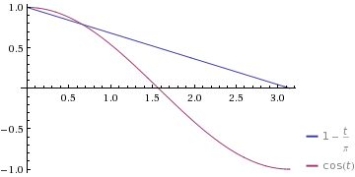
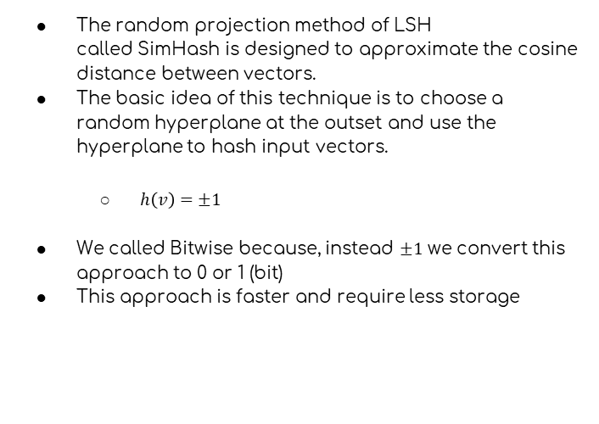
LSH – Bitwise
The random projection method of LSH called SimHash is designed to approximate the cosine distance between vectors.
The basic idea of this technique is to choose a random hyperplane at the outset and use the hyperplane to hash input vectors.
$h\left(v\right)=±1$
We called Bitwise because, instead $±1$ we convert this approach to 0 or 1 (bit)
This approach is faster and require less storage

Slide 9

No Index Structure – Test
Beside implementing the LSH index structure, we implemented a parallel structure without any indexing, just storing all the extracted features together.
Why we did that ?
In order to test and tune CNNs without the bias introduced by the LSH index approximation.
In order to compare the retrieval results and performances without index against the ones obtained by using the LSH index.

Slide 10
Features Extraction
Feature Extraction using the pretrained convolutional base
01
02
03
04
Create a image normalization preprocess with our images
Loading the pretrained DNN
Extract of the features
The result is our feature vector

Slide 11
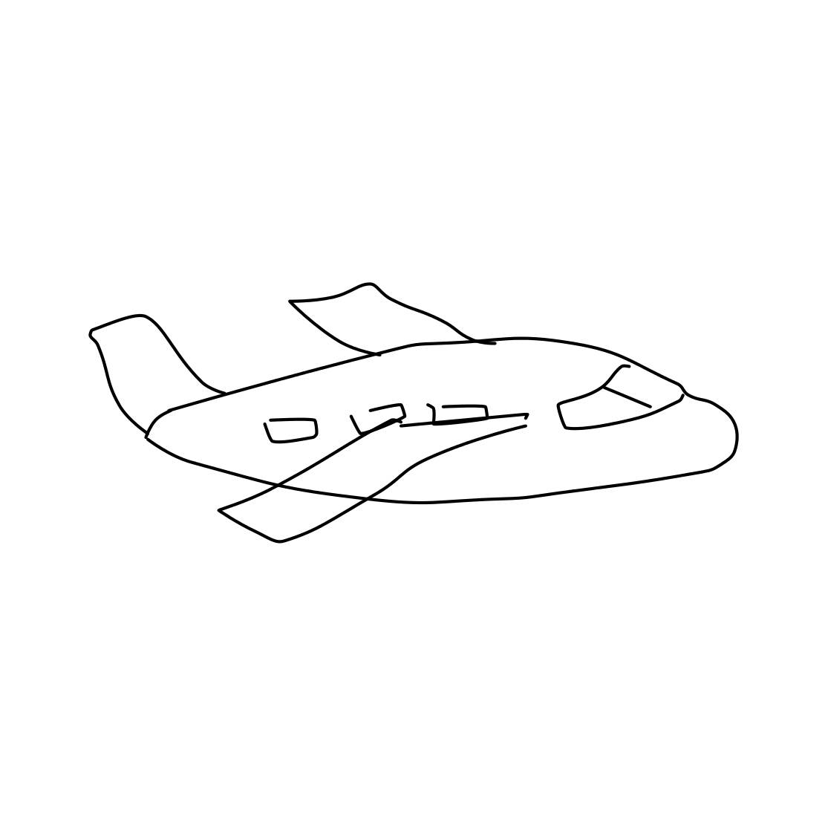
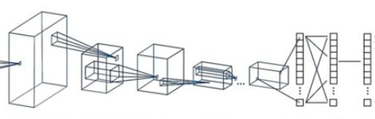

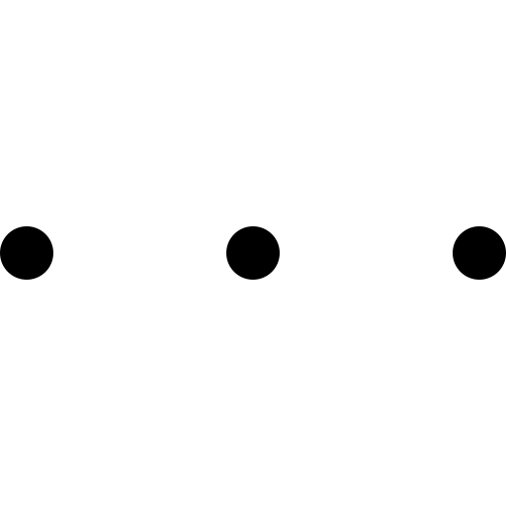
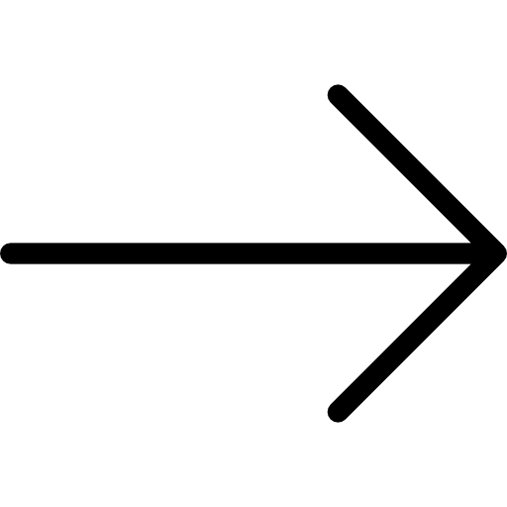
High Level Architecture
299
299
2048
Input Image
Features Extraction
LSH Index

Slide 12
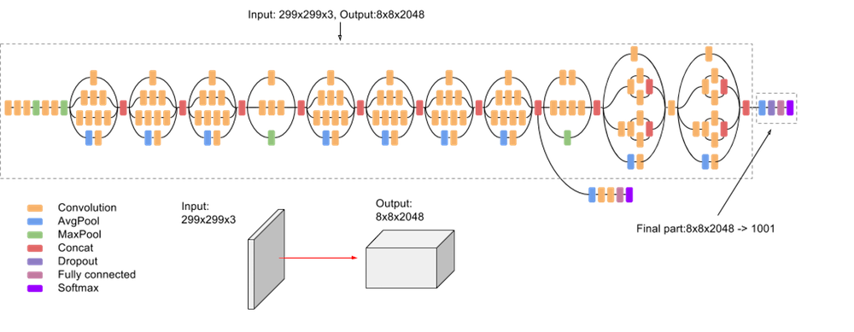
Inception V3
Have a very important milestone in the development of CNN classifiers.
The fundamental idea behind the Inception Neural Network is the inception block
Intermediate Classifiers to solve Vanishing Gradient.
Notes:
In a traditional neural network you take the output of the previous layer and that would be input to the next layer and it wourl follow that pattern all the way until the prediction
But, the inception block takess apart the individual layers and instead of just passing it through one layer it takes the previous layer input and passes it to four different operations in parallel and then concatenates the outputs for more different layers

Slide 13
Neural Network Fine Tuning Structure
…
Frozen
Load imageNet weights
Add the custom network on top of an already-trained base network
Freeze the base network
Train the part we added.
Unfreeze two inception blocks in the base network.
Jointly train both these layers and the part we added.
Fine-Tuning
Jointly fine-tune the last two inception blocks and the Custom added Network
Fine-Tuning
Custom Added Network
Note: each of the model has been trained by adopting data augmentation to generate more samples from already existing training data and to prevent overfitting.

Slide 14
Neural Network Fine Tuning Structure
…
Fine-Tuning
Add the custom network on top of an already-trained base network
Freeze the base network
Train the part we added.
Unfreeze the entire inception convolutional base network.
Jointly train both these layers and the part we added.
Fine-Tuning
Jointly fine-tune all inception blocks and the Custom added Network
Fine-Tuning
Custom Added Network
Note: each of the model has been trained by adopting data augmentation to generate more samples from already existing training data and to prevent overfitting.

Slide 15
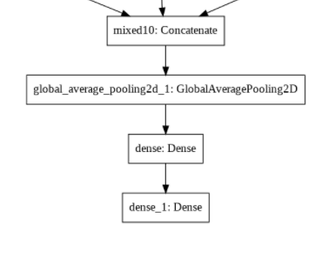
Model 1
Model with the next custom layers:
Pre-trained model Inception V3
Global spatial average pooling layer
First fully connected layer with 1024 dimensionality
Second fully connected layer with 250 dimensionality
Notes:
inception_finetuning_classification

Slide 16
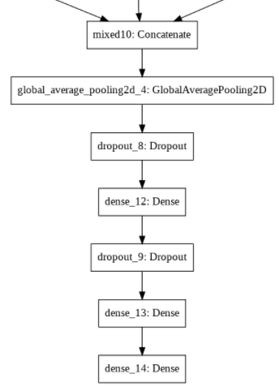
Model 2
Model with the next custom layers:
Pre-trained model Inception V3
Global spatial average pooling layer
First droupout layer with a fraction of 0.5 input units to drop
First fully connected layer with 2048 dimensionality
Second droupout layer with a fraction of the 0.5 input units to drop
Second fully connected layer with 2048 dimensionality
Third fully connected layer with 250 dimensionality
Notes:
inception_finetuning_classification_2
Base inception: Testa: Inception Block sblocatti

Slide 17
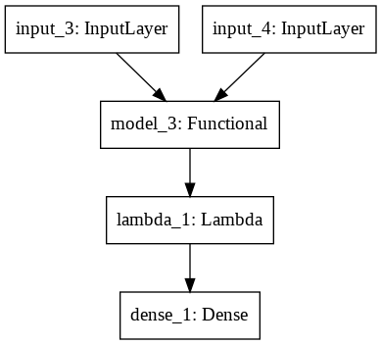
Model 3 (Siamese)
Model with the next custom layers:
Siamese neural network with the pre-trained custom model 3
Lambda layer to compute the absolute difference between the encodings (lambda tensors:K.abs(tensors[0] - tensors[1])
First fully connected layer with 1 dimensionality with a sigmoid unit to generate the similarity score
Notes:
inception_finetuning_siamese_2

Slide 18
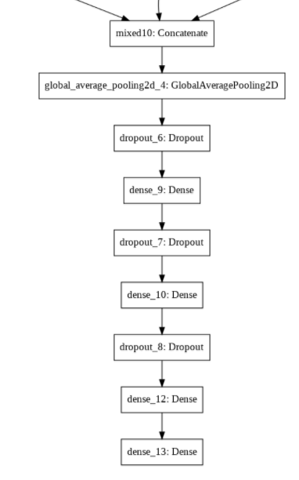
Model 4
Model with the next custom layers:
Pre-trained model Inception V3
Global spatial average pooling layer
First droupout layer with a fraction of 0.5 input units to drop
First fully connected layer with 2048 dimensionality
Second droupout layer with a fraction of the 0.5 input units to drop
Second fully connected layer with 2048 dimensionality
Second droupout layer with a fraction of the 0.5 input units to drop
Third fully connected layer with 2048 dimensionality
Fourth fully connected layer with 250 dimensionality
Notes:
inception_finetuning_classification_3_last_one_more_train

Slide 19
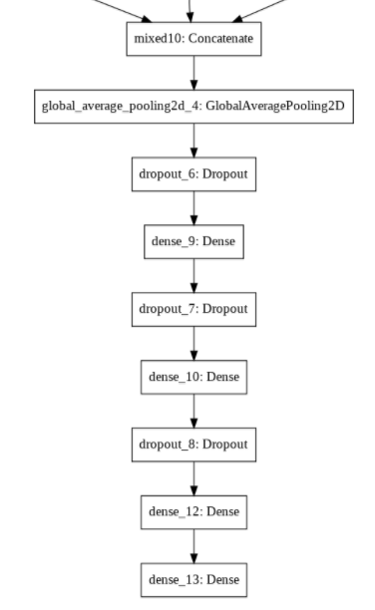
Model 5 (Best Model)
Model with the next custom layers:
Pre-trained model Inception V3
Global spatial average pooling layer
First droupout layer with a fraction of 0.5 input units to drop
First fully connected layer with 2048 dimensionality
Second droupout layer with a fraction of the 0.5 input units to drop
Second fully connected layer with 2048 dimensionality
Second droupout layer with a fraction of the 0.5 input units to drop
Third fully connected layer with 2048 dimensionality
Fourth fully connected layer with 250 dimensionality
Notes:
inception_finetuning_classification_3_last_one_more_train_all_parameters_more_train

Slide 20
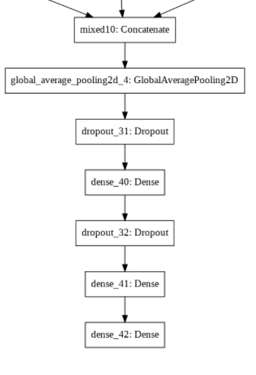
Model 6
Model with the next custom layers:
Pre-trained model Inception V3
Global spatial average pooling layer
First droupout layer with a fraction of 0.5 input units to drop
First fully connected layer with 4096 dimensionality
Second droupout layer with a fraction of the 0.5 input units to drop
Second fully connected layer with 4096 dimensionality
Third fully connected layer with 250 dimensionality
Notes:
inception_finetuning_classification_dense_only_4096

Slide 21
Model Test and Performance
Model name | Train |  | Test |  | Euclidean mAP on train | Cosine mAP on train | Euclidean mAP using test | Cosine mAP using test
 | Loss | Accuracy | Loss | Accuracy
Model 1 | 1.2724 | 0.6617 | 1.2328 | 0.6648 | 0.1452 | 0.1687 | 0.0763 | 0.0821
Model 3 (Siamese) | 0.4611 | 0.8157 | 0.8868 | 0.7373 | 0.2674 | 0.3175 | 0.2618 | 0.3264
Model 2 | 0.9033 | 0.7612 | 0.9272 | 0.762 | 0.3035 | 0.346 | 0.2889 | 0.3464
Model 4 | 0.894 | 0.7667 | 0.9065 | 0.761 | 0.2896 | 0.3539 | 0.2993 | 0.3784
Model 6 | 0.76 | 0.7867 | 0.8022 | 0.784 | 0.3068 | 0.4071 | 0.2935 | 0.3797
Model 5 (Best) | 0.6899 | 0.8087 | 1.0764 | 0.709 | 0.4294 | 0.4711 | 0.3731 | 0.4047
Notes:
Model Withouth Finetuning

Slide 22
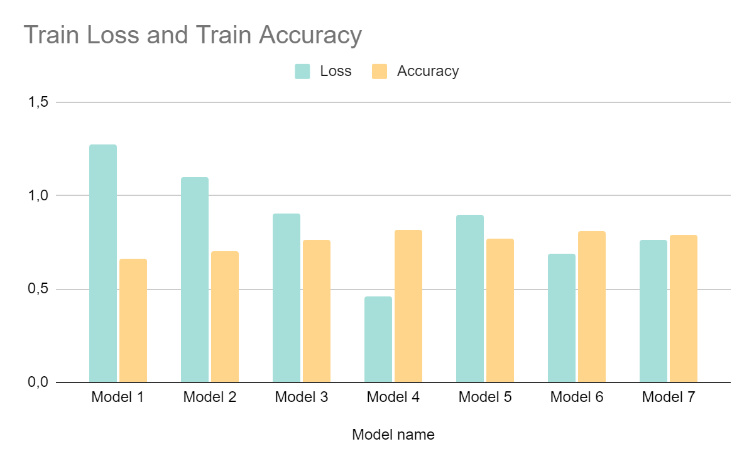
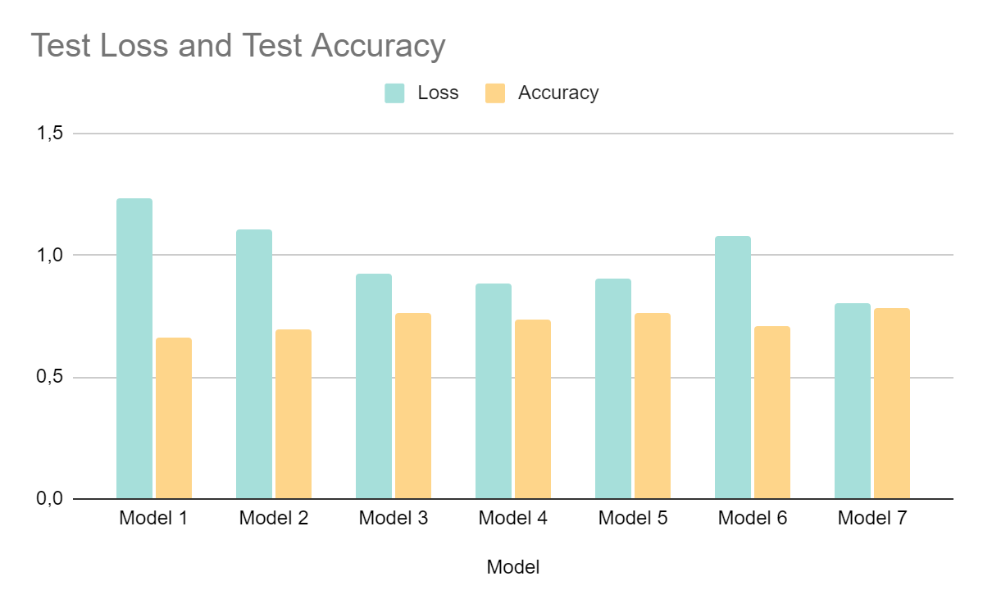
Model Test and Performance

Slide 23
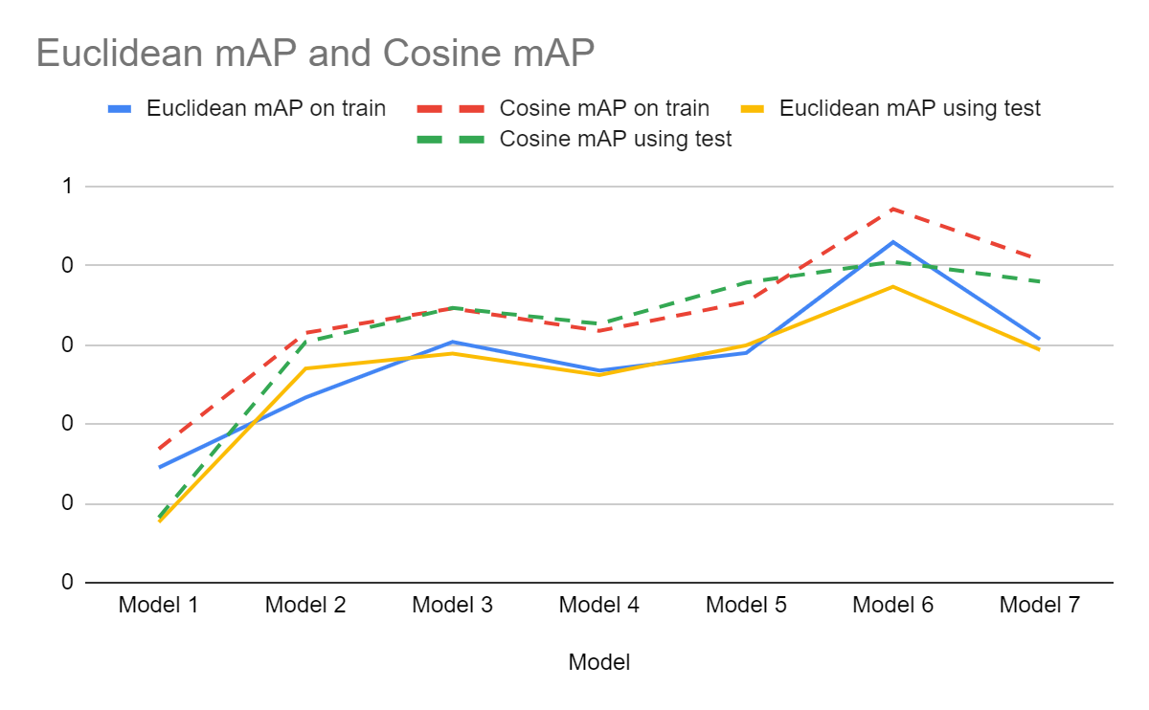
Model Test and Performance

Slide 24
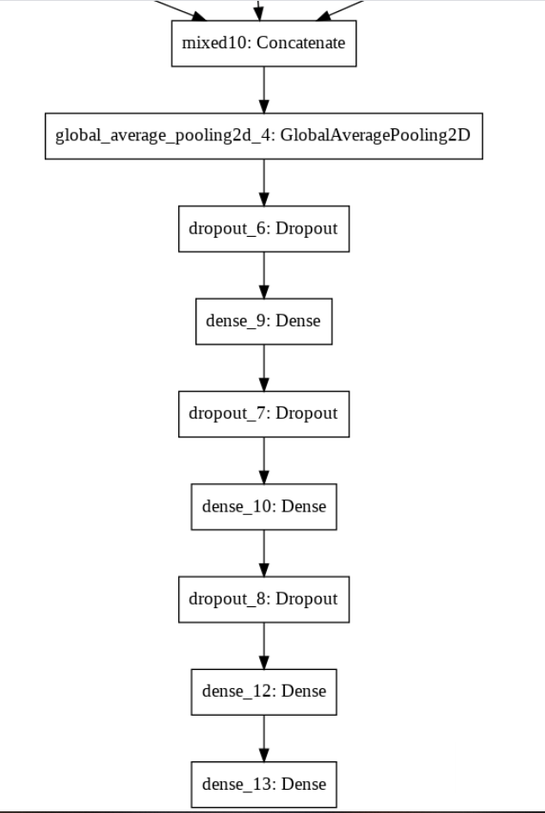
Best Model Chosen: Model 5
We choose the model with the next custom layers:
Pre-trained model Inception V3
Global spatial average pooling layer
First droupout layer with a fraction of 0.5 input units to drop
First fully connected layer with 2048 dimensionality
Second droupout layer with a fraction of the 0.5 input units to drop
Second fully connected layer with 2048 dimensionality
Second droupout layer with a fraction of the 0.5 input units to drop
Third fully connected layer with 2048 dimensionality
Fourth fully connected layer with 250 dimensionality

Slide 25
LSH Tuning (G and H)
LSH | Test mAP |  | Test IE |  | Bucket Purity AVG | Bucket Purity STD | # Buckets | # Items | # AVG per BUCKET | # STD per BUCKET
 | Euc | Cos | Euc | Cos
G = 3, H = 5 | 0,01 | 0,02 | 3775,31 | 4000,96 | 0,87 | 0,24 | 24363 | 120000 | 4,93 | 36,3
G = 3, H = 3 | 0,06 | 0,06 | 387,62 | 269,23 | 0,72 | 0,32 | 4885 | 120000 | 24,5 | 183,97
G = 5, H = 2 | 0,18 | 0,19 | 6,68 | 9,31 | 0,61 | 0,35 | 1629 | 200000 | 122,77 | 642,32
G = 4, H = 2 | 0,17 | 0,20 | 11,2 | 14,3 | 0,62 | 0,34 | 1188 | 160000 | 134,68 | 677,15
G = 7, H = 2 | 0,24 | 0,26 | 5,8 | 3,9 | 0,62 | 0,34 | 2319 | 280000 | 120,7 | 722,83
G = 8, H = 2 | 0,25 | 0,27 | 1,9 | 2,69 | 0,62 | 0,35 | 2548 | 320000 | 125,59 | 688,5
G = 5, H = 1 | 0,31 | 0,37 | 0,52 | 0,46 | 0,52 | 0,35 | 150 | 200000 | 1333,3 | 3571,97
$Improvement Efficency=\frac{Cost No Index}{Cost with Index}$ Where $Cost=\# of Computed Distances$

Slide 26
LSH BitWise - Tuning (G and H)
LSH BitWise | Test mAP |  | Test IE |  | Bucket Purity AVG | Bucket Purity STD | # Buckets | # Items | # AVG per BUCKET | # STD per BUCKET
 | Euc | Cos | Euc | Cos
G = 3, H = 6 | 0,28 | 0,32 | 8 | 8,2 | 0,3 | 0,25 | 192 | 120000 | 625 | 1502,5
G = 3, H = 5 | 0,30 | 0,33 | 5 | 4,67 | 0,26 | 0,27 | 96 | 120000 | 1250 | 2733
G = 4, H = 4 | 0,32 | 0,39 | 1,36 | 1,37 | 0,37 | 0,32 | 64 | 160000 | 2500 | 3220,32
G = 5, H = 5 | 0,31 | 0,39 | 2,23 | 2,2 | 0,29 | 0,26 | 160 | 200000 | 1250 | 2347
G = 3, H = 1 | 0,35 | 0,42 | 0,26 | 0,26 | 0,52 | 0,27 | 6 | 120000 | 20000 | 8807
G = 5, H = 2 | 0,36 | 0,42 | 0,31 | 0,31 | 0,35 | 0,36 | 20 | 200000 | 10000 | 8618,35
$Improvement Efficency=\frac{Cost No Index}{Cost with Index}$ Where $Cost=\# of Computed Distances$

Slide 27
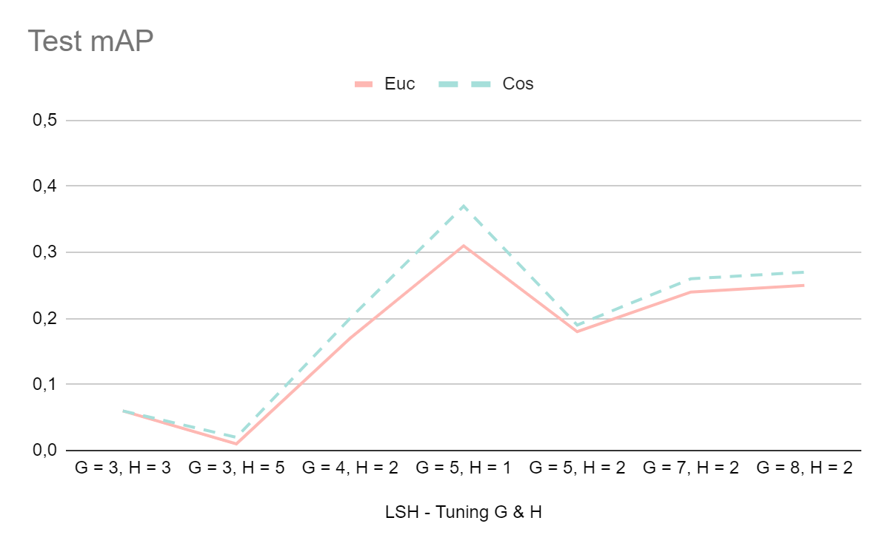
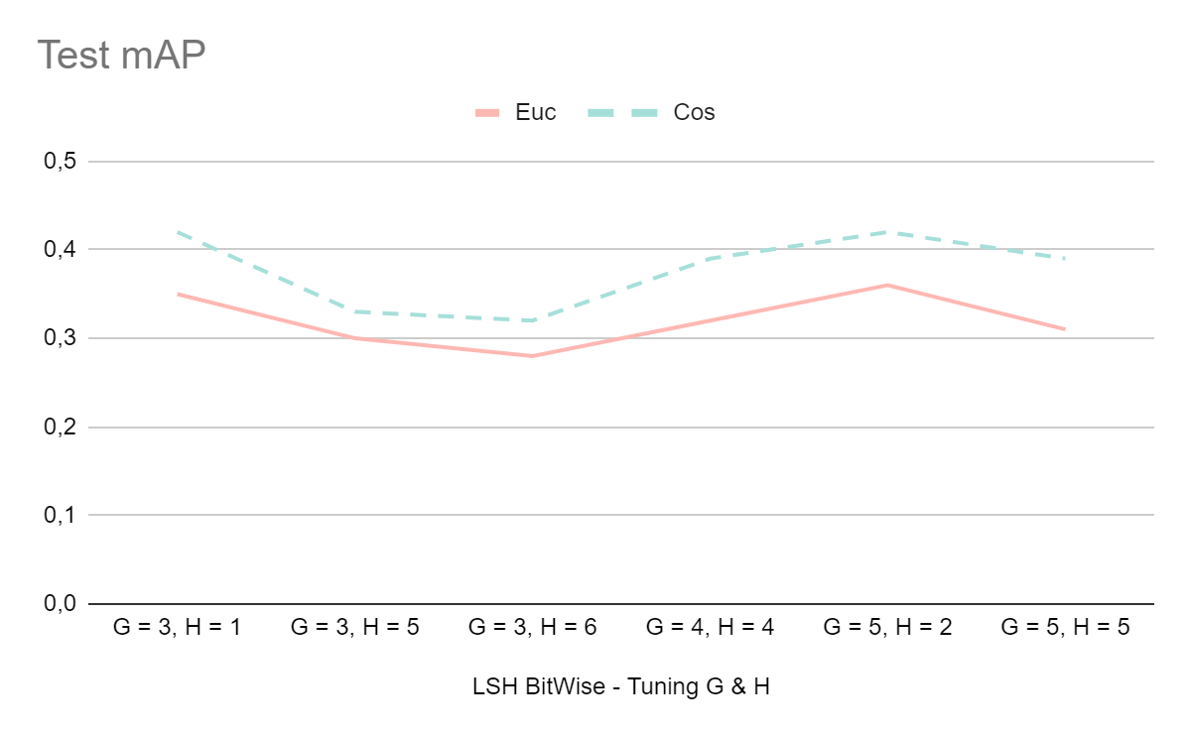
Test mAP - Graph comparation

Slide 28
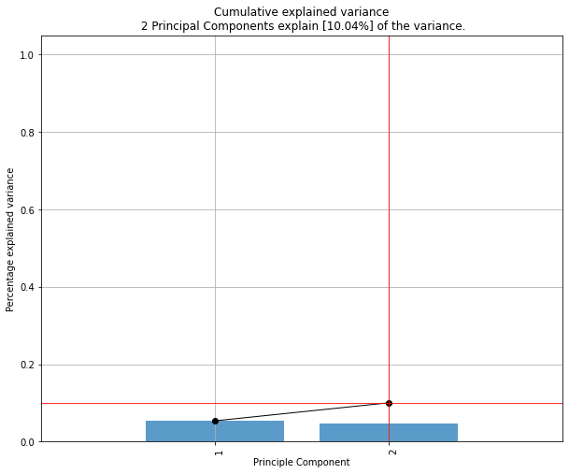
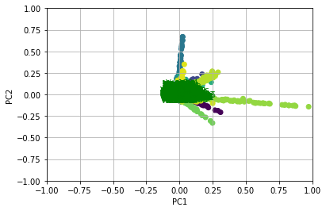
PCA - Principal Component Analysis
We tried to carry out the PCA in order to see:
The possibility of represent features extracted in the new space obtained by using the first two principal components.
But, the first two principal components only explain 10% of the variance of our data:
As you can see in the second graph, the features of the various classes are largely overlapped with no clear clusters distinguishable.

Slide 29
Accuracy and mAP analysis class by class
For each class, iteratively query the sketches dataset, using each time one object of the class as query to retrieve all the others.
for each class c for each class sample s execute_query(s) compute_AP(s) compute_mAP(c) compute_max(AP, c) compute_min(AP, c) compute_range(AP, c) compute_std(AP, c) show_best_sketch(c) show_worst_sketch(c)
01
Compute the Average Precision for each query
02
For each class, compute mAP, min(AP), max(AP), std(AP), range(AP)
03
Return the Sketch for which the max(AP) score has been obtained and the sketch for which the mix(AP) score has been obtained
04

Slide 30
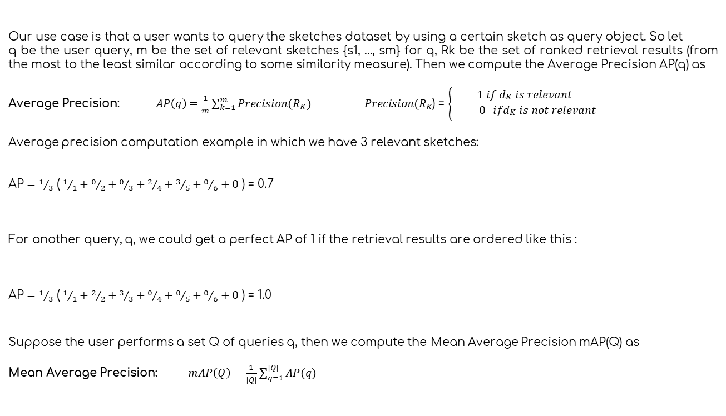
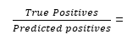
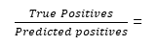
Mean Average Precision
Our use case is that a user wants to query the sketches dataset by using a certain sketch as query object. So let
q be the user query, m be the set of relevant sketches {s1, ..., sm} for q, Rk be the set of ranked retrieval results (from the most to the least similar according to some similarity measure). Then we compute the Average Precision AP(q) as
Average Precision: $AP\left(q\right)=\frac{1}{m}\sum_{k=1}^{m}{Precision(R_{K})}$ $Precision(R_{K}$) = $\left\{\begin{aligned}1 if d_{\begin{aligned}K \\ \end{aligned}} is relevant \\ 0 ifd_{\begin{aligned}K \\ \end{aligned}} is not relevant\end{aligned}\right.$
Average precision computation example in which we have 3 relevant sketches:
$\text{AP}=$ $1/3$ ( $1/1+0/2+0/3+2/4+3/5+0/6+0$ ) = 0.7
For another query, q, we could get a perfect AP of 1 if the retrieval results are ordered like this :
$\text{AP}=$ $1/3$ ( $1/1+2/2+3/3+0/4+0/5+0/6+0$ ) = 1.0
Suppose the user performs a set Q of queries q, then we compute the Mean Average Precision mAP(Q) as
Mean Average Precision: $mAP\left(Q\right)=\frac{1}{|Q|}\sum_{q=1}^{|Q|}{AP(q)}$
$\frac{True Positives}{Predicted positives}$ =
…
$$1/1$$
$$0/2$$
$0/$3
$$1/4$$
$$1/5$$
$0/$6
$$0/n$$
…
$\frac{True Positives}{Predicted positives}$ =
$$1/1$$
$$1/2$$
$1/$3
$0/$4
$$0/5$$
$0/$6
$0/$n

Slide 31
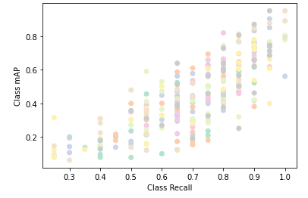
Recall Vs Mean Average Precision
Beside computing the mAP for each of the 250 sketches classes, we even computed the Recall for each class. What is the percentage of samples belonging to each class correctly recognized (labeled) by our deep learning model? Then we carried out a correlation analysis between Recall and mAP by class, below the scatter plot is reported.
Correlation coefficient:
0.7863
There is a significant positive correlation between Recall and mAP by class.

Slide 32
Results for some of the well recognized classes
? =

Slide 33
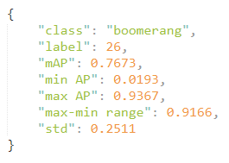
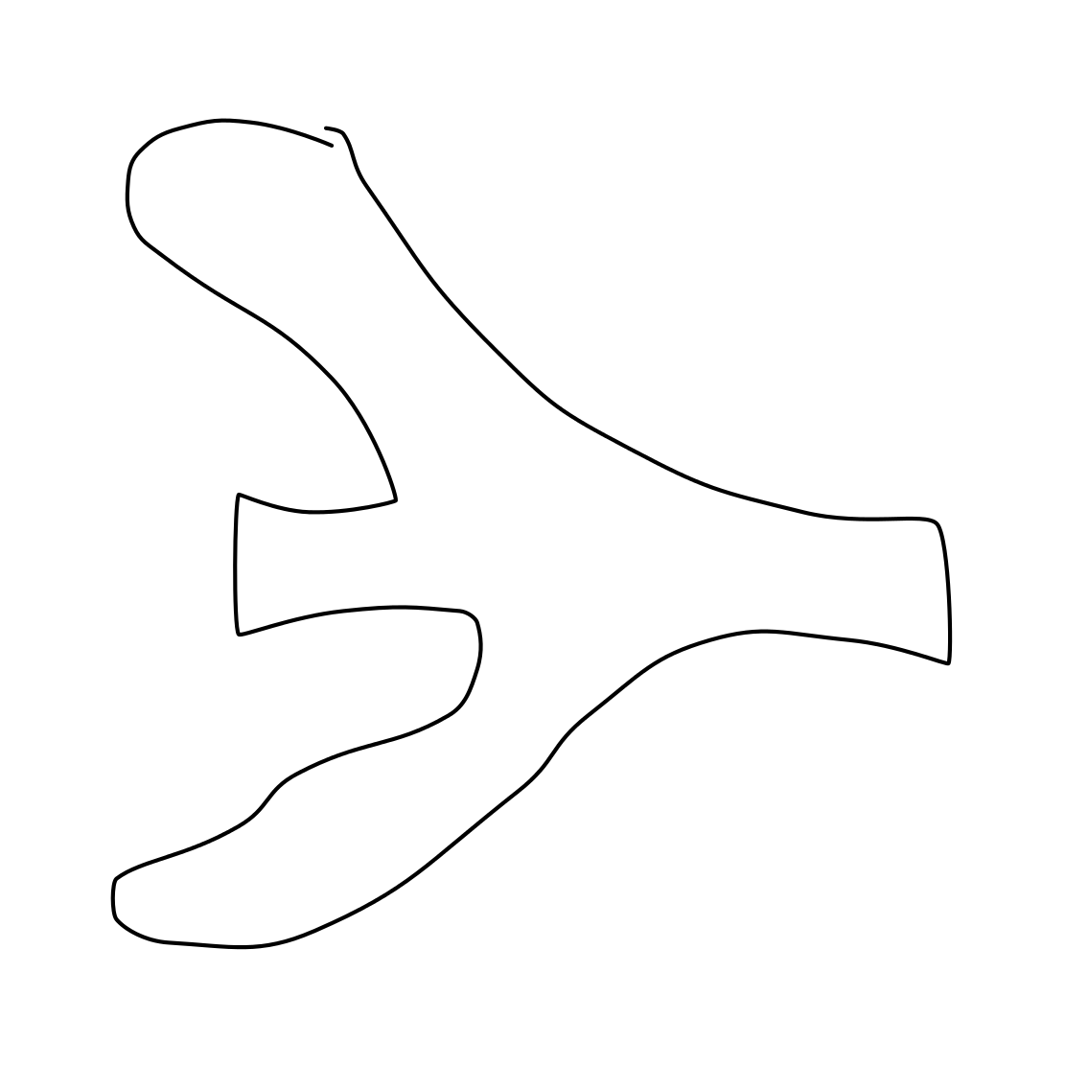
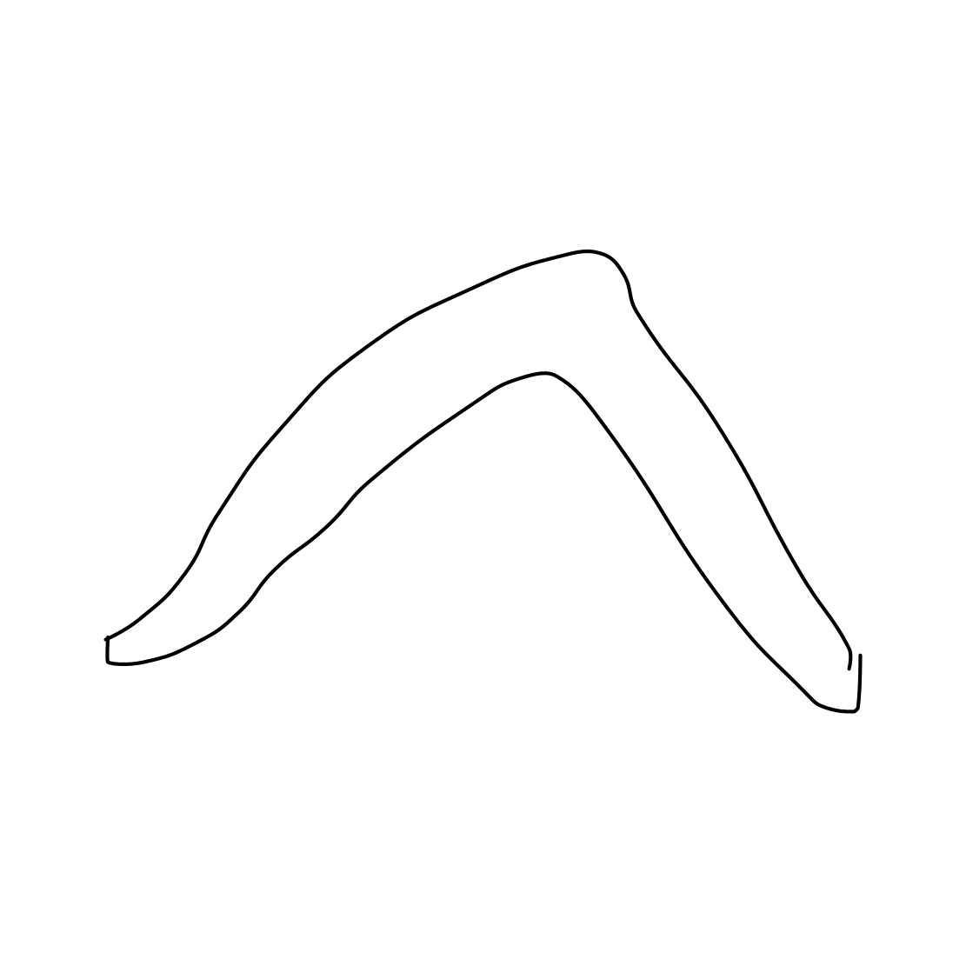
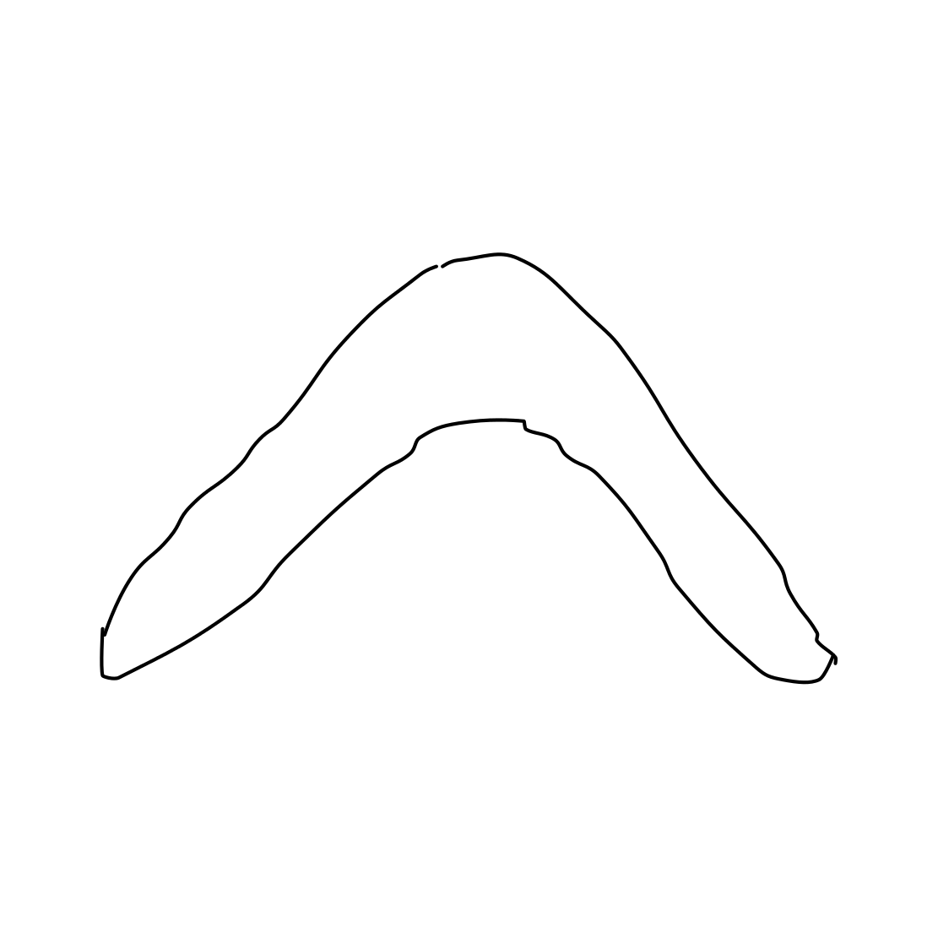
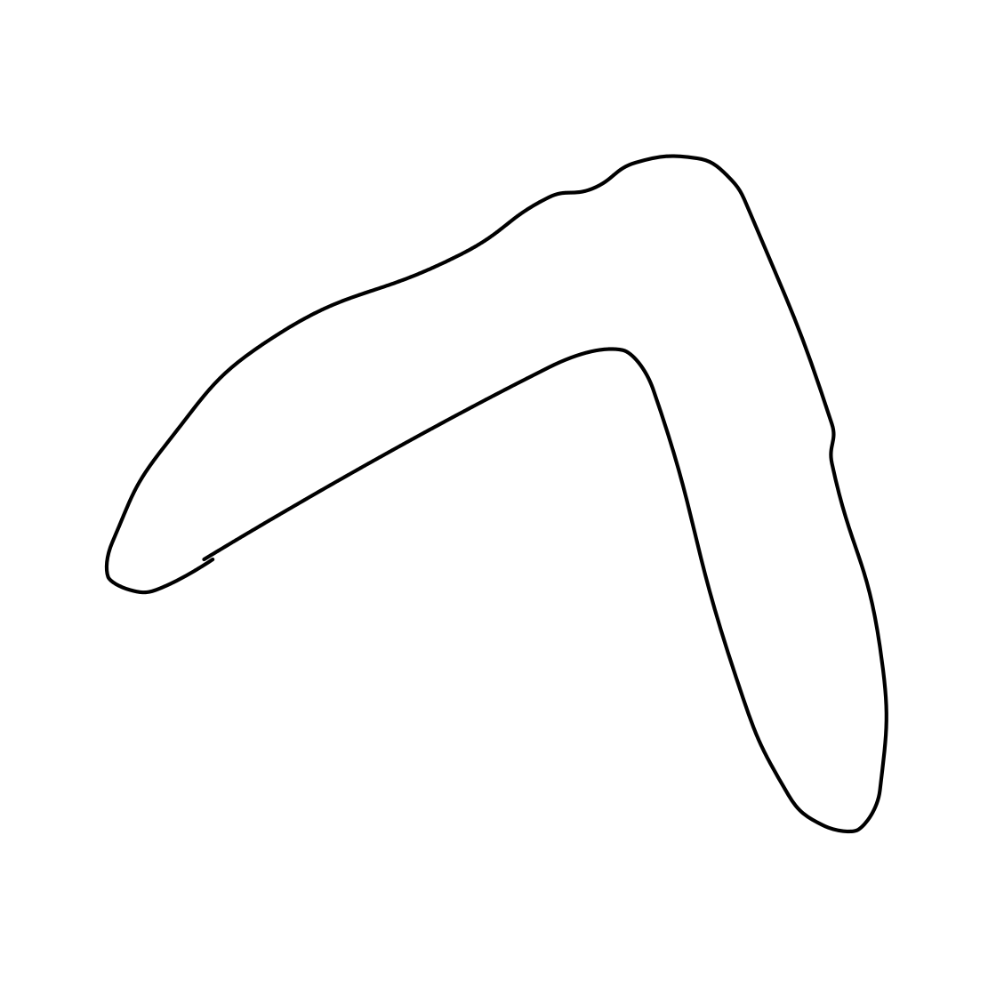
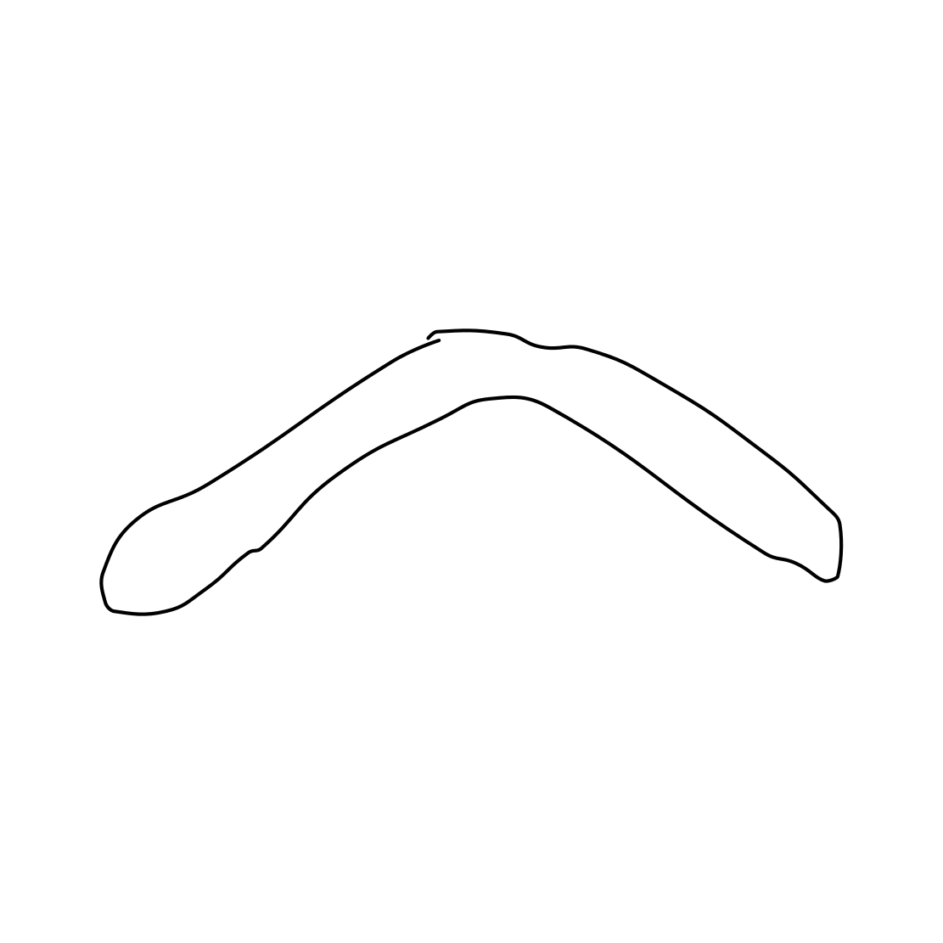
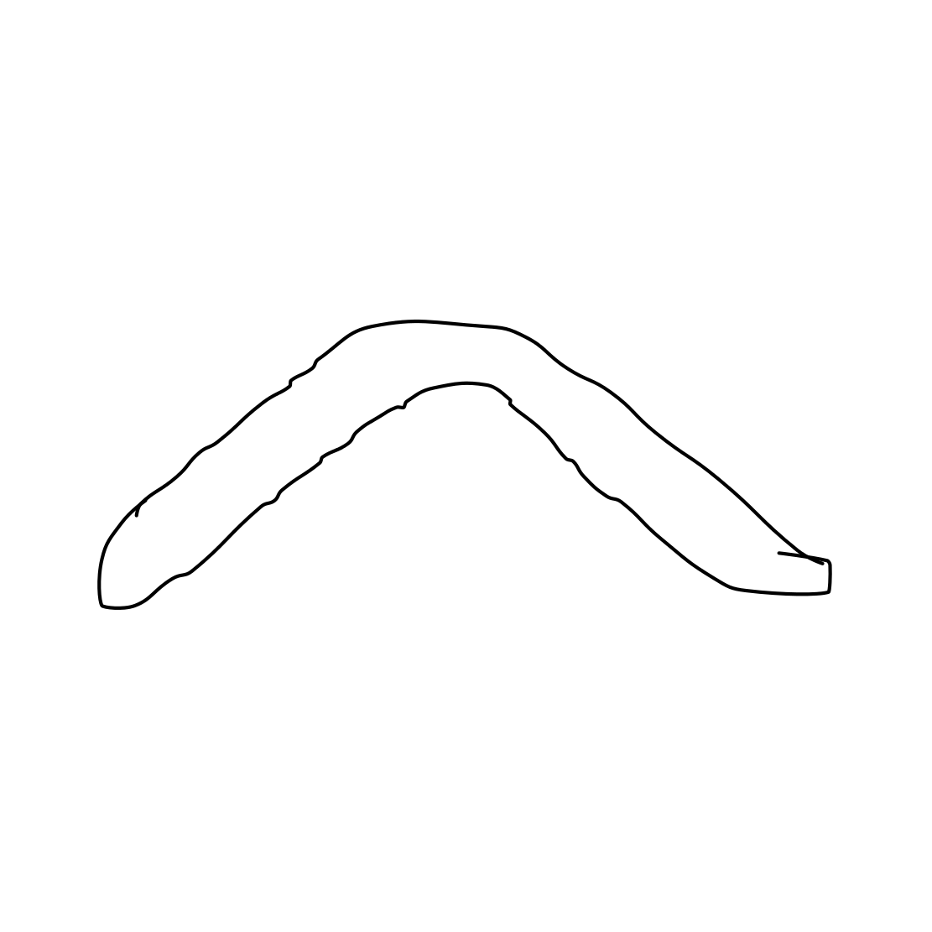
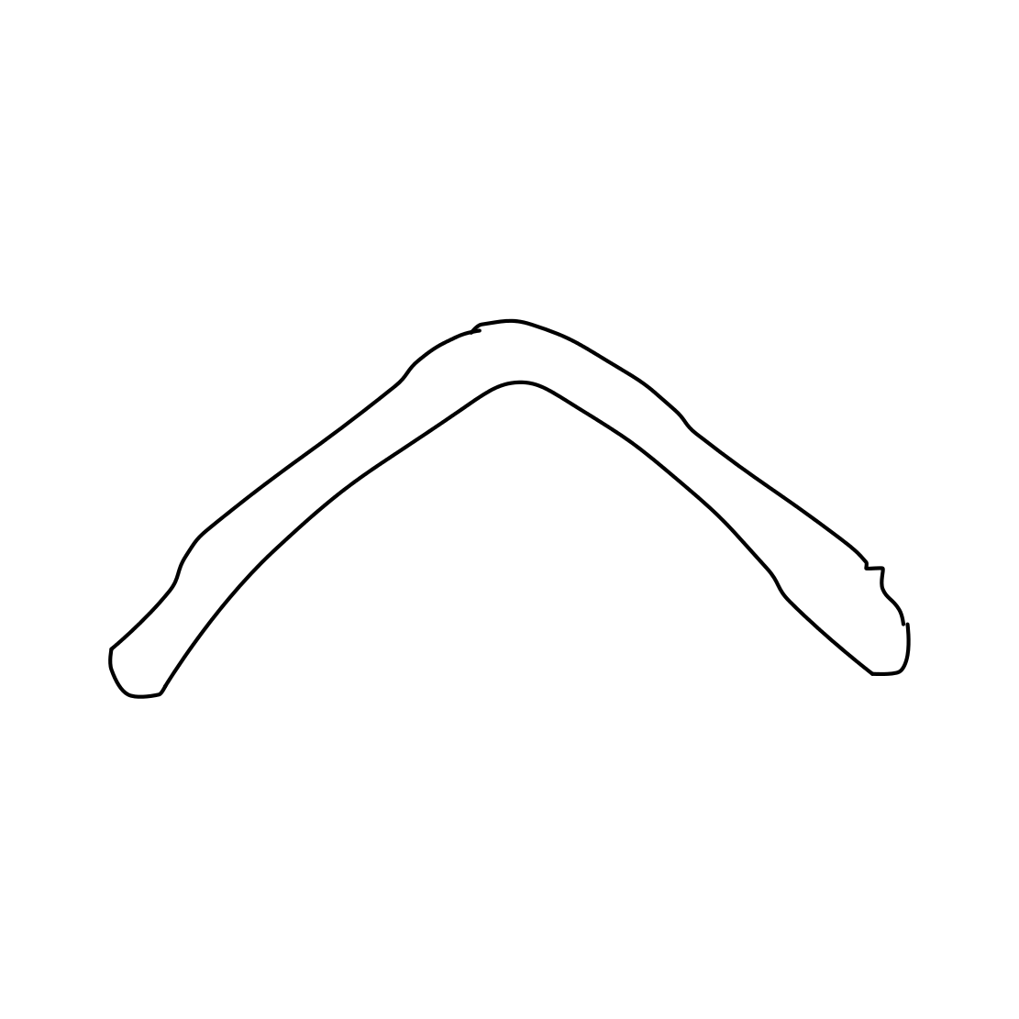
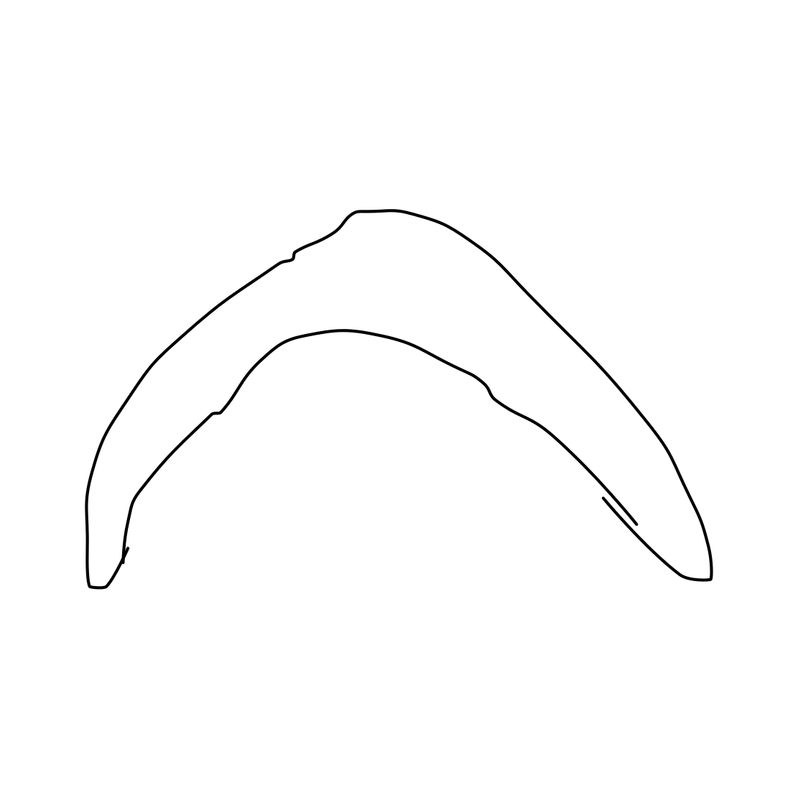


Class Boomerang: mAP 0.77 Recall 0.90
Worst sketch: AP = 0.0125
Best sketch: AP = 0.936
Some other sketches from the boomerang class:

Slide 34
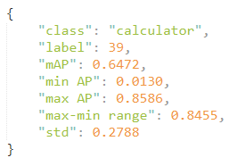
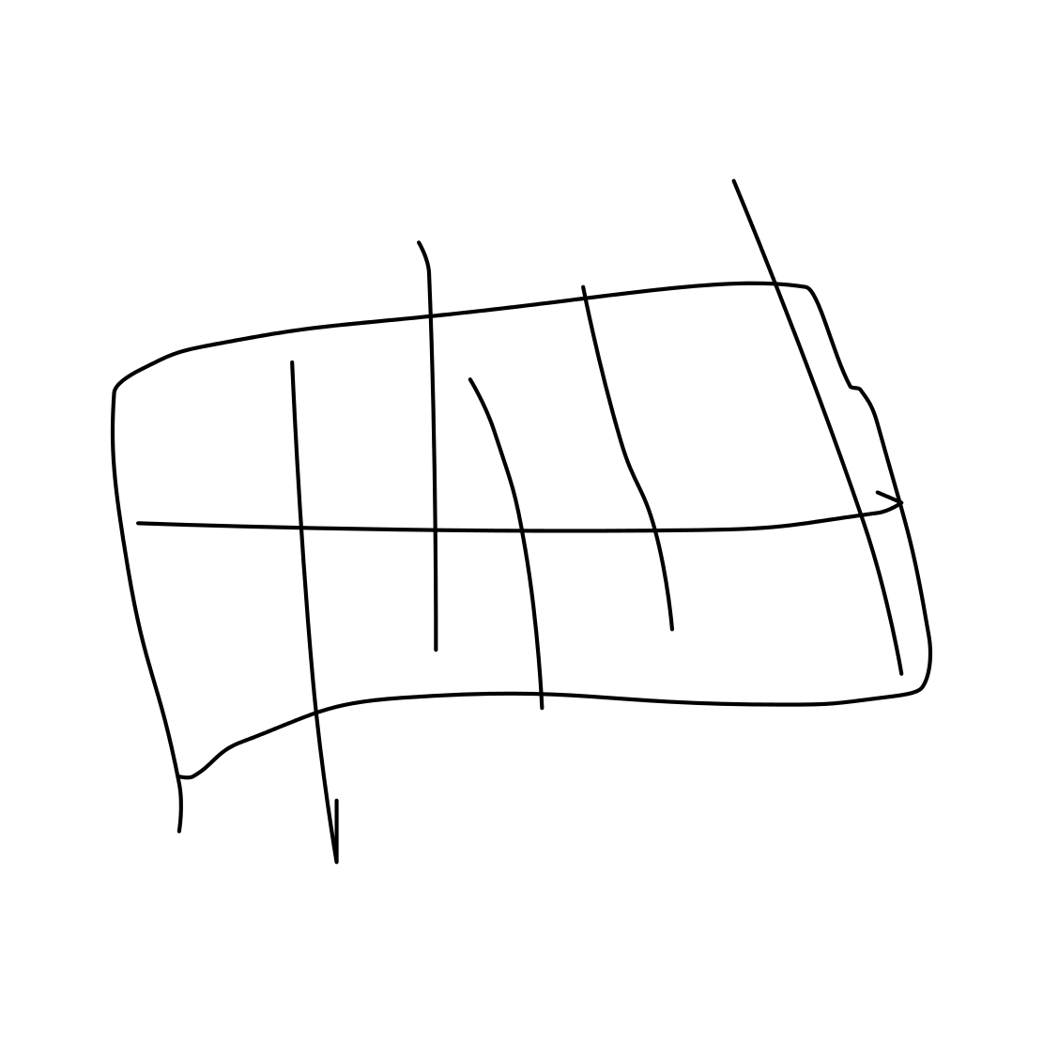
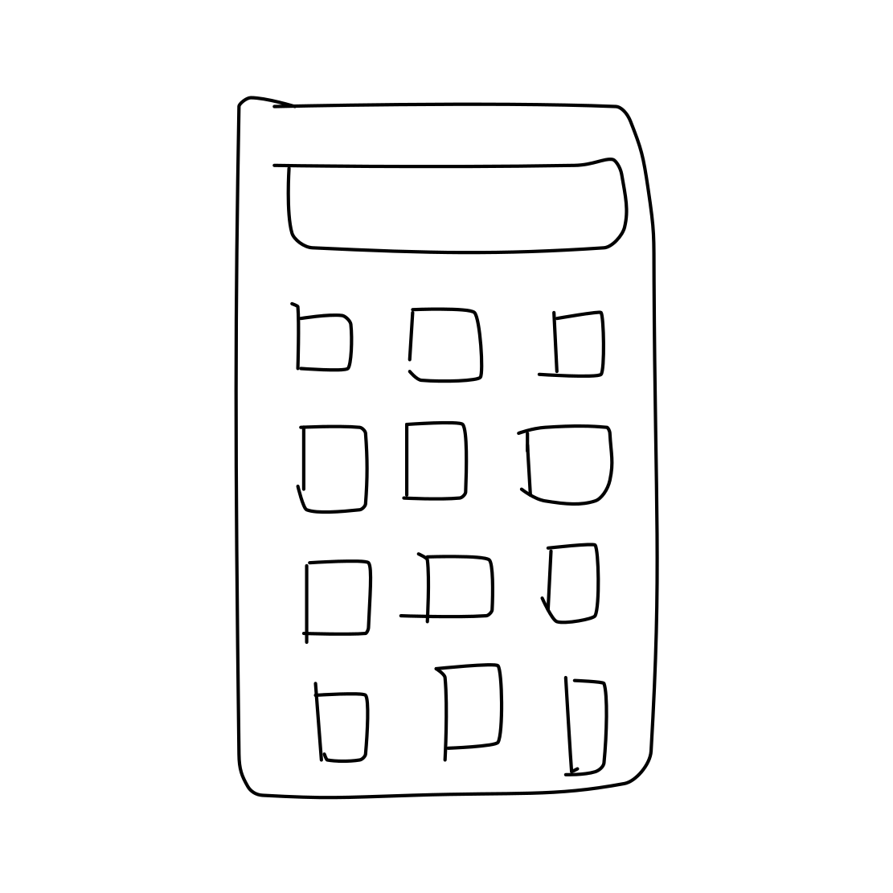
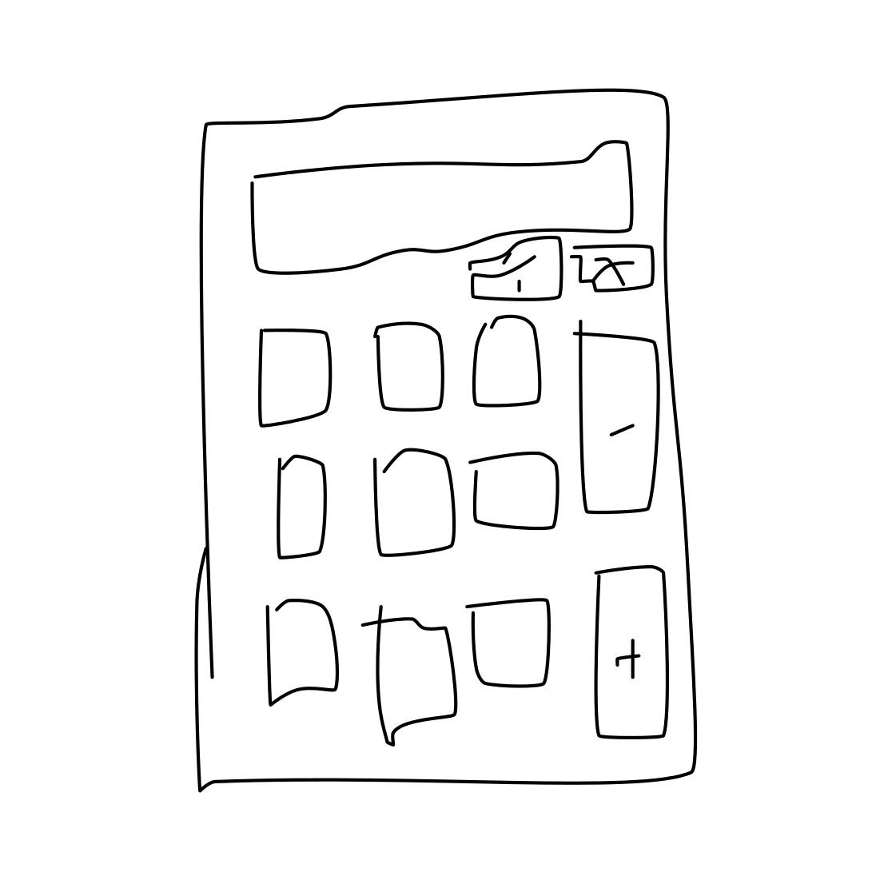
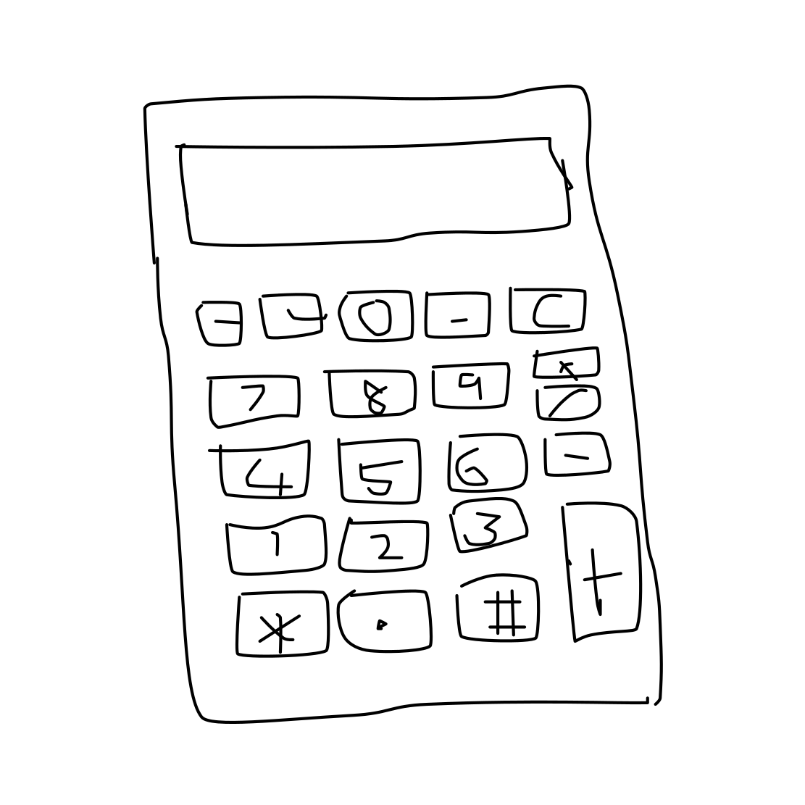
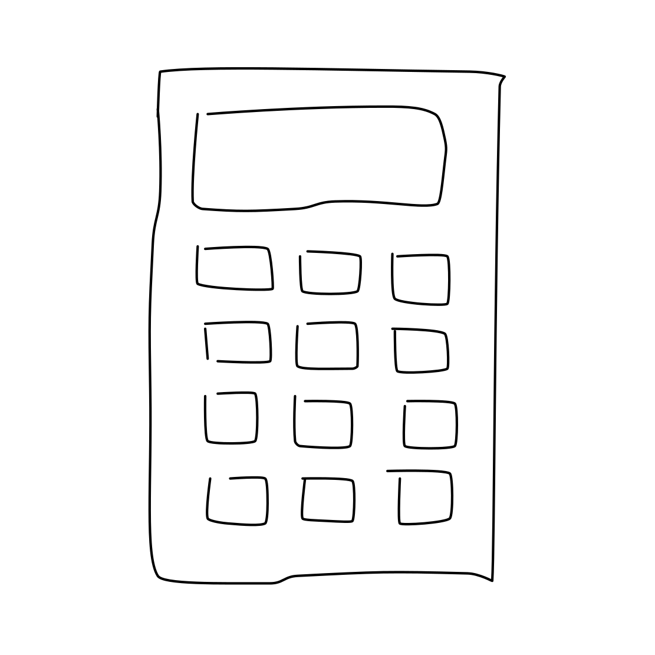
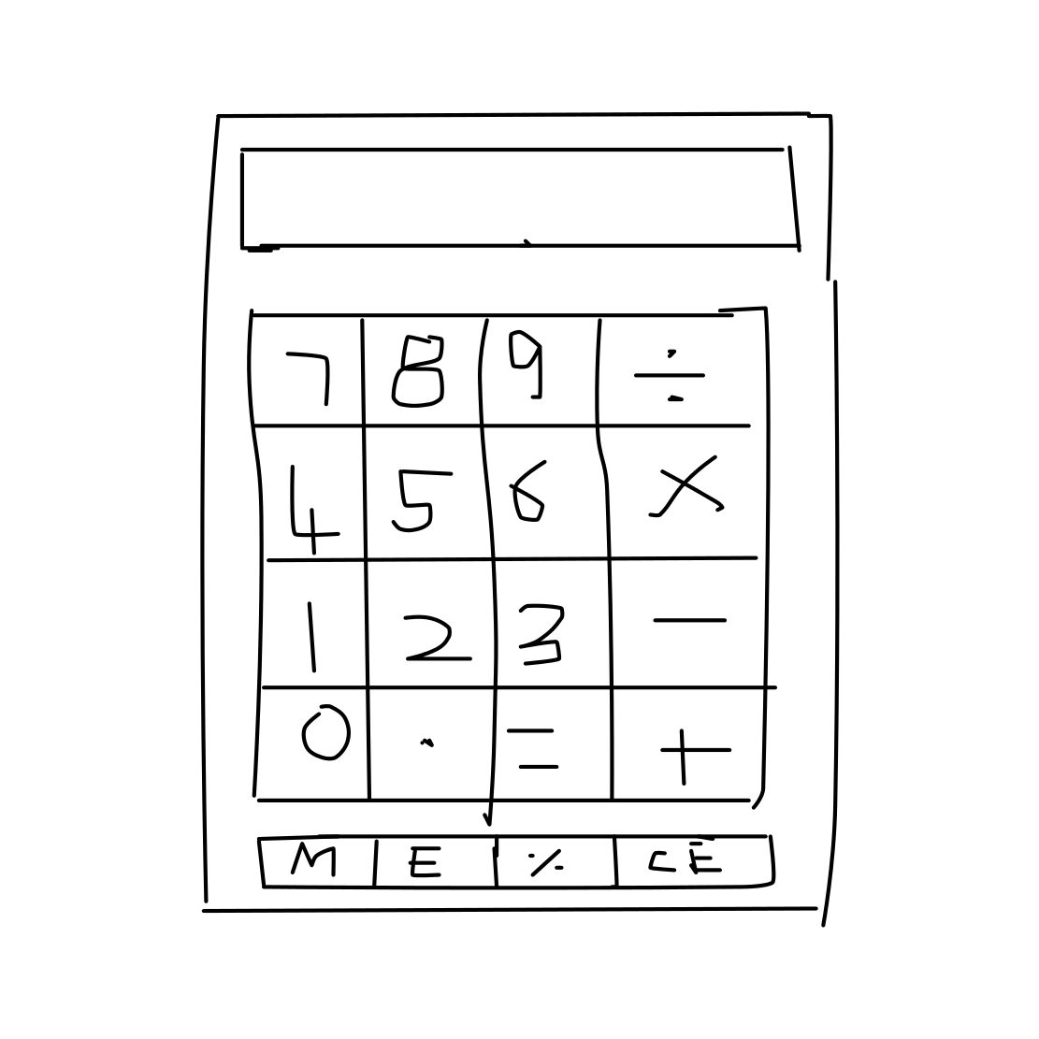
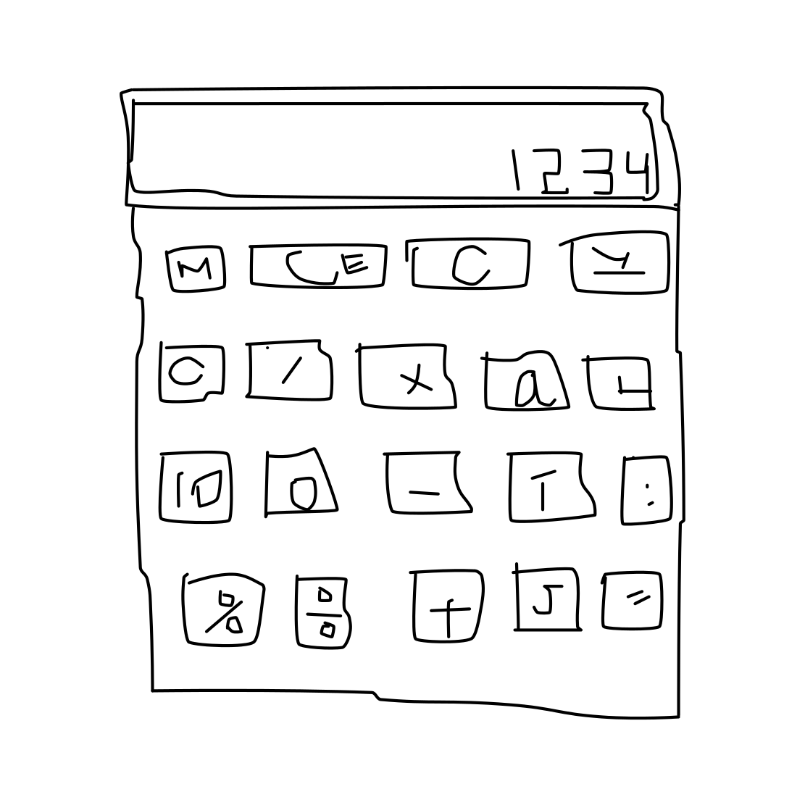
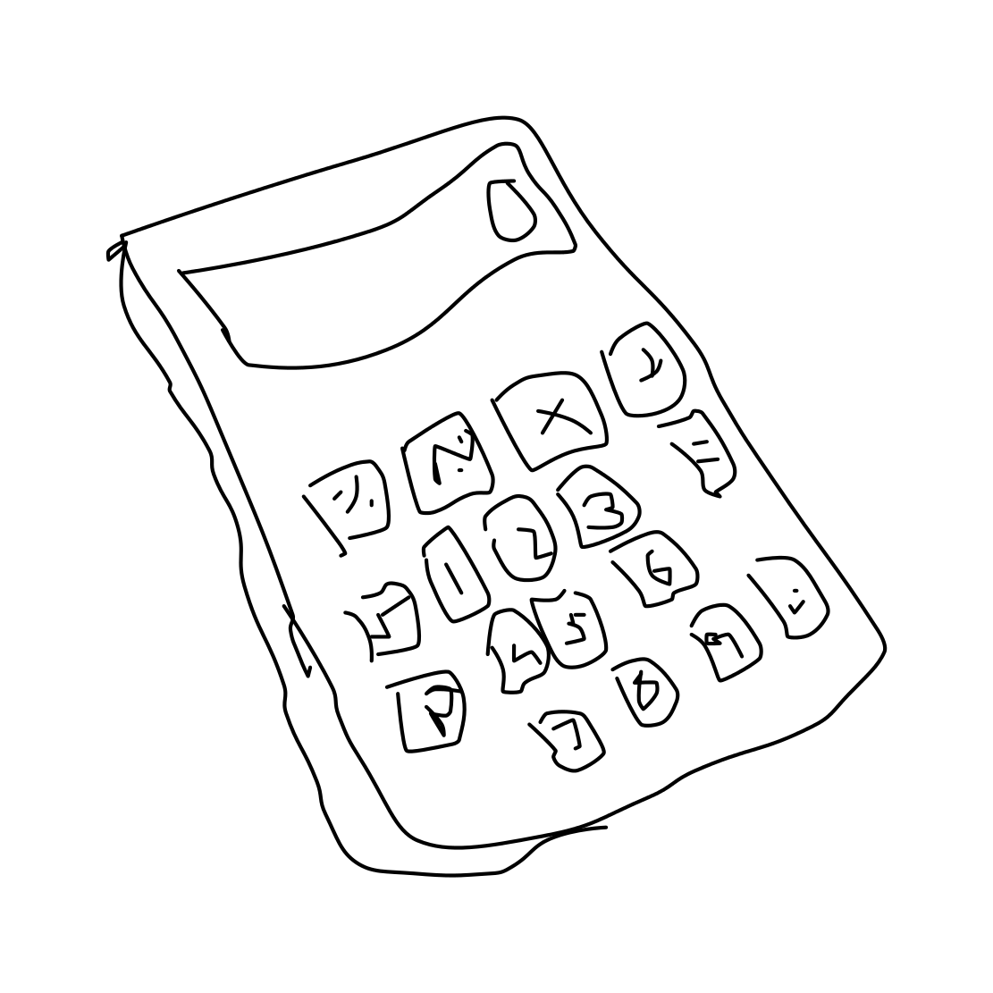


Class Calculator: mAP 0.65 Recall 0.85
Worst sketch: AP = 0.0131
Best sketch: AP = 0.8586
Some other sketches from the calculator class:

Slide 35
Results for some of the bad recognized classes
? =

Slide 36














Class Dog: mAP 0.10 Recall 0.30
Worst sketch: AP = 0.012
Best sketch: AP = 0.3210
Some other sketches from the calculator class:

Slide 37














Class Loudspeaker: mAP 0.09 Recall 0.25
Worst sketch: AP = 0.0125
Best sketch: AP = 0.2202
Some other sketches from the calculator class:

Slide 38
Most Frequent Misclassifications
For some of the worse recognized classes, we got the predictions in output from our deep learning model in order to check with which other classes the model makes confusion.
?

Slide 39


Slide 40


Slide 41



WEB Sketches Recognition Architecture
User
User Input
Web Interface
LSH Index
Output sketches

Slide 42

DEMO

Slide 43
Project Source Code
Analysis_By_Class
MIRCV
MIRCV_Functions
Pca_Try
accuracy_assessment
evaluate_models
lsh_finetuning
lsh_finetuning_bucket_dispersion
mAP_by_class
save_index
siamese_finetuning
sketches
web

Slide 44
RESOURCES
Papers
Rethinking the Inception Architecture for Computer Visual
A Simple Guide to the Versions of the Inception Network
A Neural Network for PCA and Beyond
Theory and Applications of b-Bit Minwise Hasing
A Neural Network for PCA
Locality-sensitive hashing
Locality-Sensitive Hashing Scheme Based on p-Stable Distributions
Similarity Search in High Dimensions via Hashing
How Do Humans Sketch Objects?
One Shot Learning with Siamese Network using Keras

Slide 45
THANKS!

